Slide 1

Solver

Slide 2
Problem A Company makes two types of leather belts A and B. A is a high quality of belt and B is a lower quality belt. The respective profits are Rs 4 and Rs 3 per belt. The production of A requires twice as much time as a belt of type B, and if all belts were of type B, the company could make 1000 belts per day. The supply of leather is sufficient for only 800 belts per day for both A and B. Belt A requires a fancy buckle and only 400 of these buckles are available per day. There are only 700 buckles a day available for belt B. What should be the daily production of each type of belt for maximizing the profit?

Slide 3
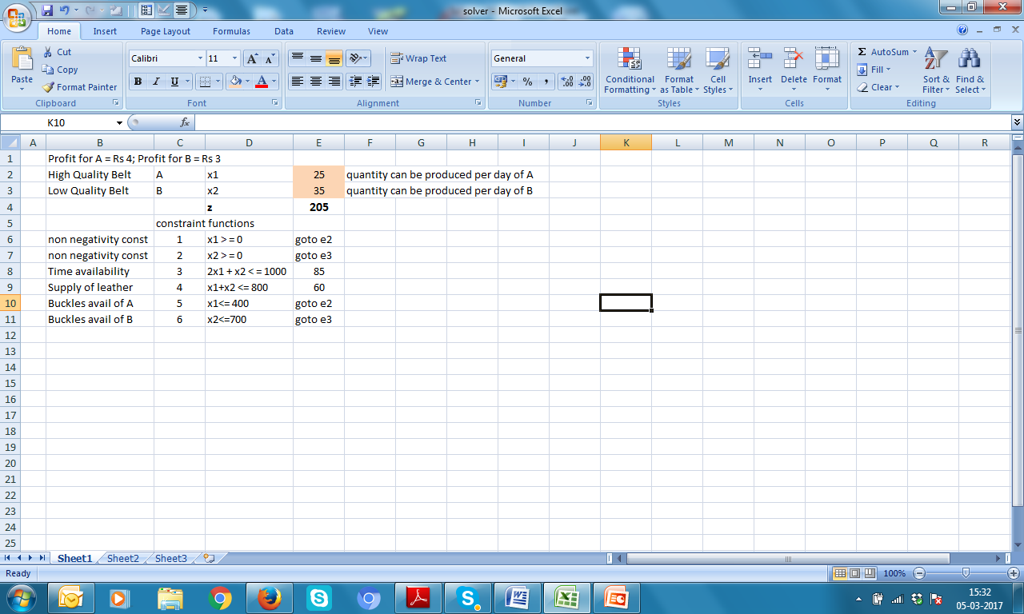
First set up excel sheet like this

Slide 4
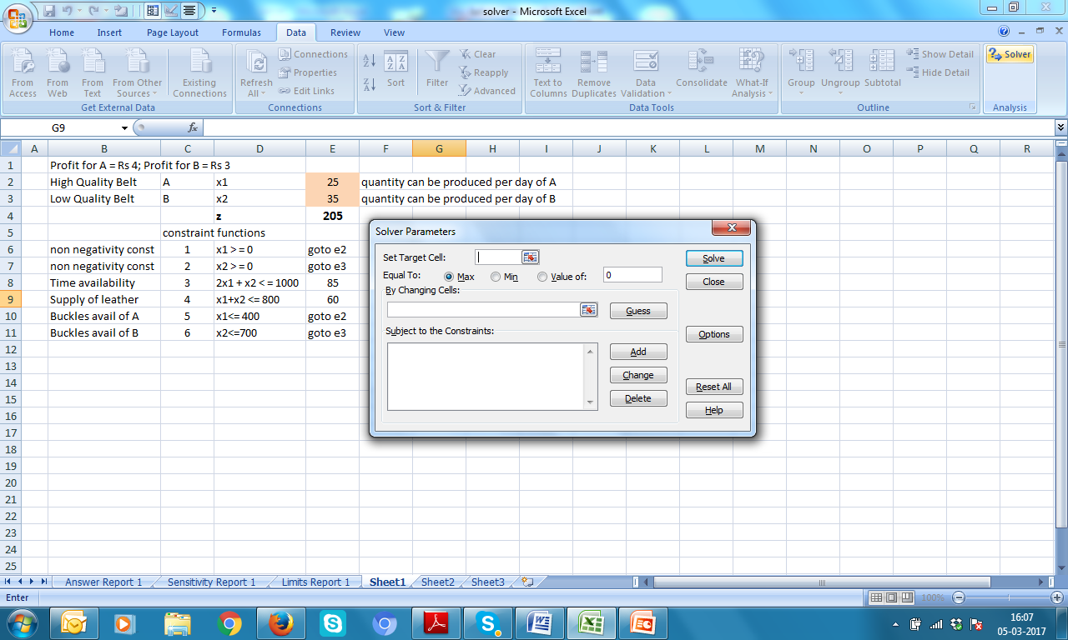
1. Click Data
2. Click Solver

Slide 5
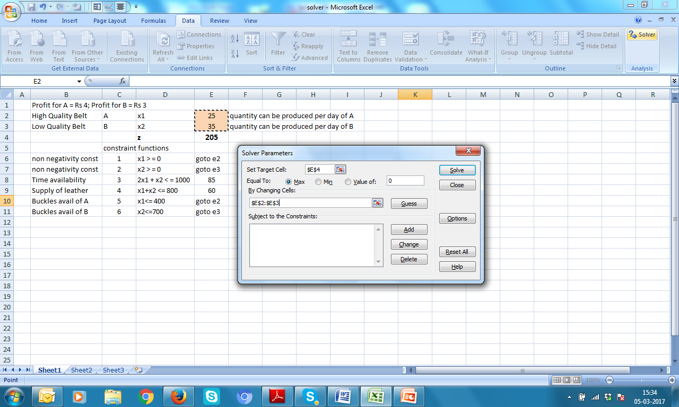
Set Target Cell as E4 and By Changing Cells: E2:E3
Click Add

Slide 6
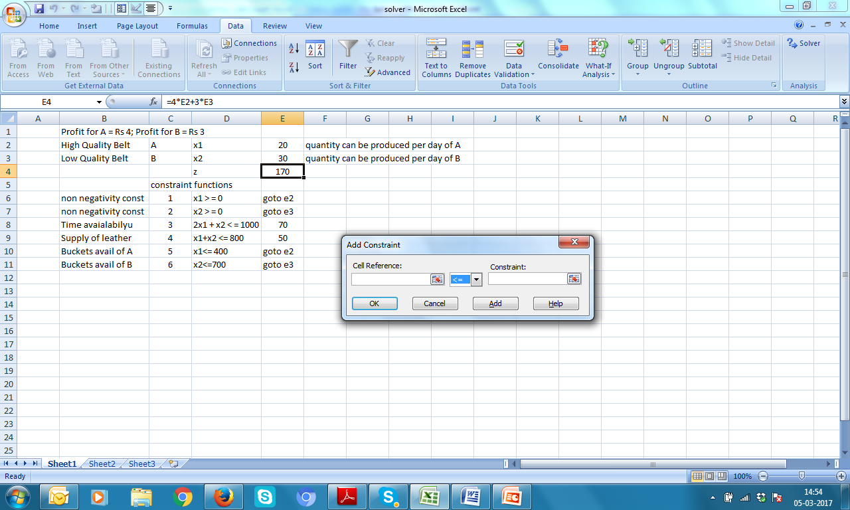

Feeding
Constraints

Slide 7
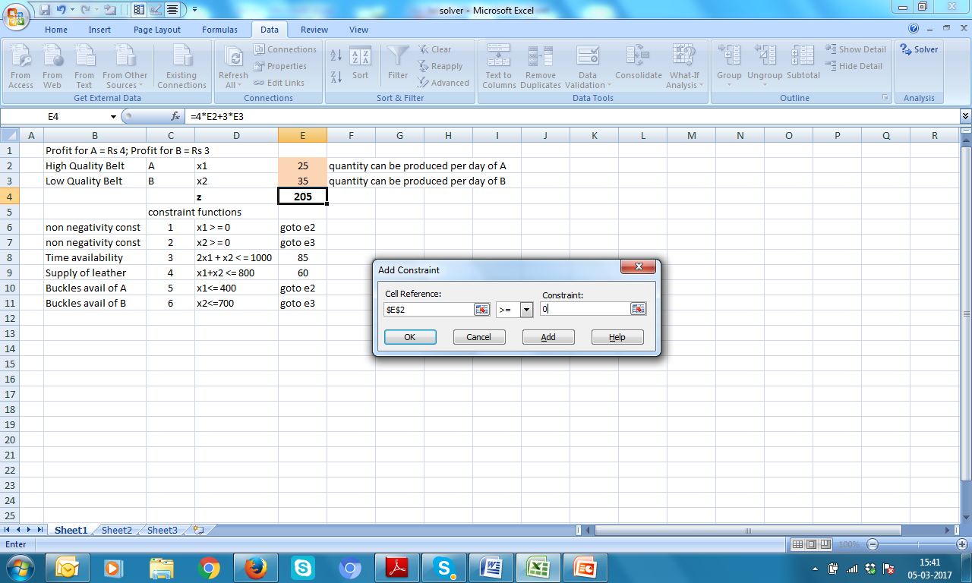
First constraint of non negativity OF x1
Don’t feed this cell, E6, by mistake
E2 >= 0, click Add

Slide 8

Second constraint of non negativity OF x2
Don’t feed this cell, E7, by mistake
E3 >= 0, click Add

Slide 9

Third constraint of Time Availability
E8 < = 1000, click Add
Don’t feed this cell figure, 85, by mistake

Slide 10

Fourth constraint of Supply of Leather
E9 < = 800, click Add
Don’t feed this cell figure, 60, by mistake

Slide 11

Fifth constraint of Buckles availability for A
E2 < = 400, click Add
Don’t feed this cell, E10, by mistake

Slide 12
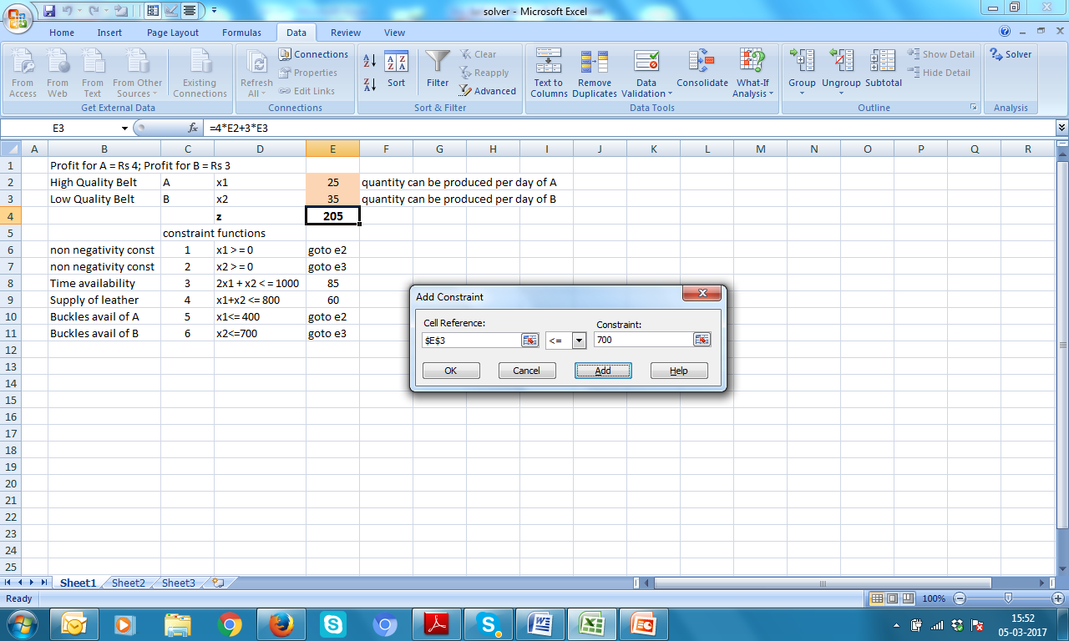
Sixth constraint of Buckles availability for B
E3 < = 700, (i) click Add THEN (ii) Cancel
Don’t feed this cell, E11, by mistake

Slide 13
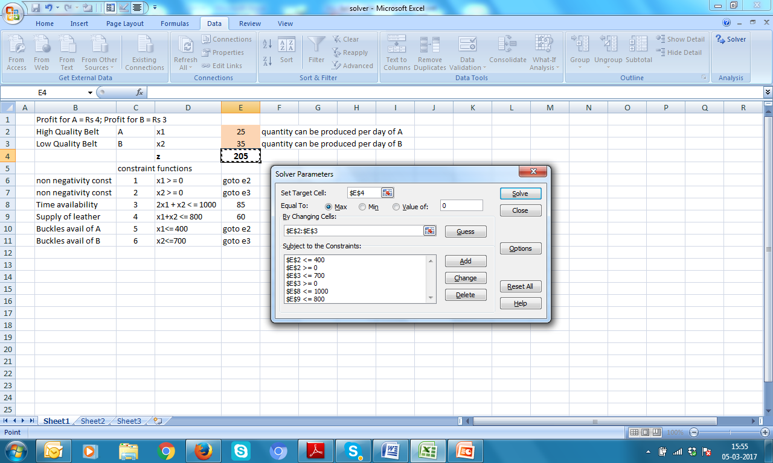
2. Click Solve
1. Check constraints meticulously

Slide 14

Wait for pressing OK for few
seconds more

Slide 15
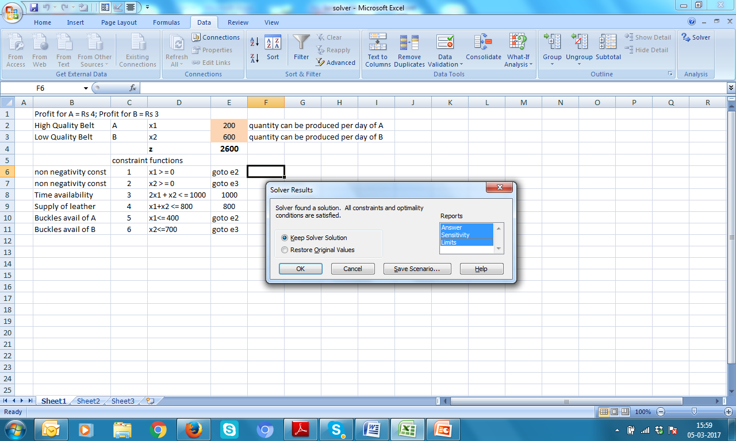

1. Select these reports
2. Now press

Slide 16
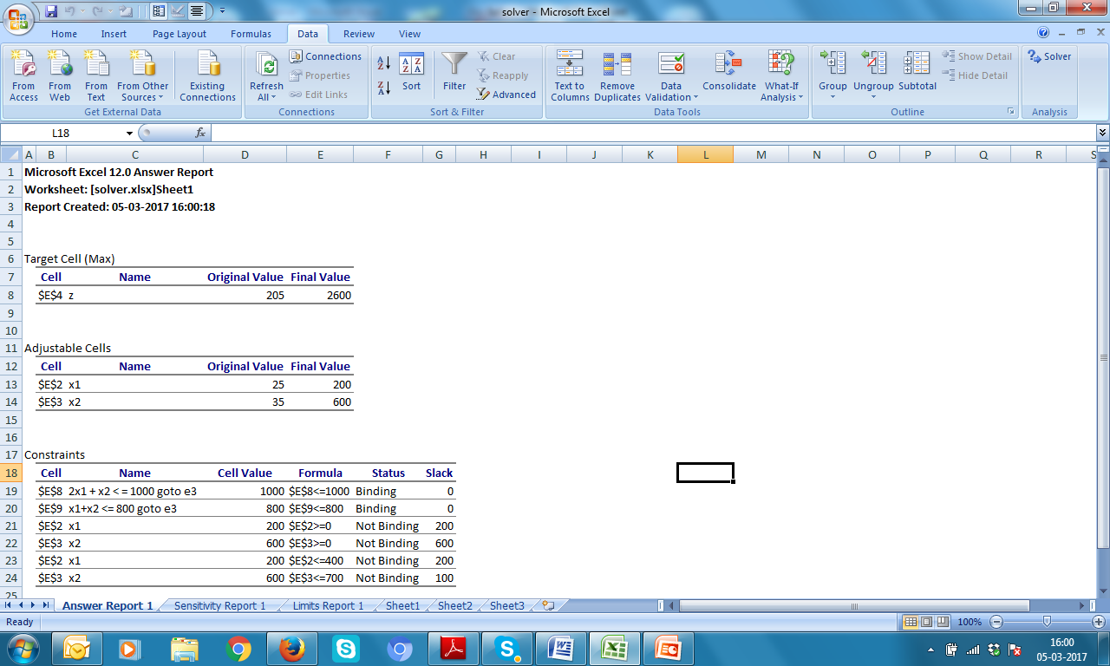

Slide 17
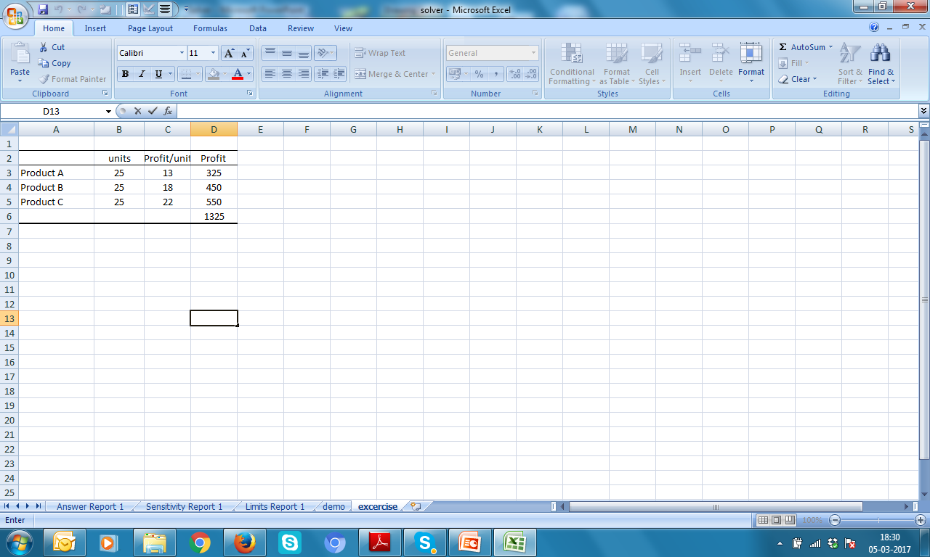
Exercise Consider the following information:
the combined production capacity is 300 units/day
the company needs to produce minimum 50 units of Product A to fill an existing order
the company needs to produce minimum 40 units of Product B to fill an existing order
because the market for Product C is relatively limited, the company does not want to produce more than 40 units
Find how many units are to be produced for maximizing profit.

